Slide 1
Human neural dynamics of real-world and imagined navigation
Seeber et al. 2025
Nature Human Behavior

Slide 2
Introduction
5 participants
Epilepsy patients with chronic/mobile iEEG implants.
Responsive Neurostimulation Device (NeuroPace)
Participants memorized a real-world navigational task.
After memorizing the task, they also imagined the task.

Slide 3
Introduction
Prior to navigational decision points, MTL electrodes showed bouts of increased power in the theta band.
Similar theta dynamics were also present in imagined trials.
Statistical model successfully reconstructed real-world and imagined positions from the neural data.

Slide 4
PSA About Epilepsy
Beneficence
Undergrads get educational experience and compensation.
Epilepsy patients get medical treatment and compensation.
But patients are also volunteers.
Incredibly important contributors to cognitive-neuroscience.
Notes:
Do people have friends or family with epilepsy?
This is sort of a note-to-self because I’ve been presenting a lot of human ieeg papers
These guys are good sports, and the contribution they make to science is much larger than whatever might gain personally.
Human Neuroscience is built on the investigation of participants with neuropathologies.

Slide 5

Notes:
Jennifer aniston neuron tells us a lot about what is possible in human neural representation that we’d never get from animal models.

Slide 6
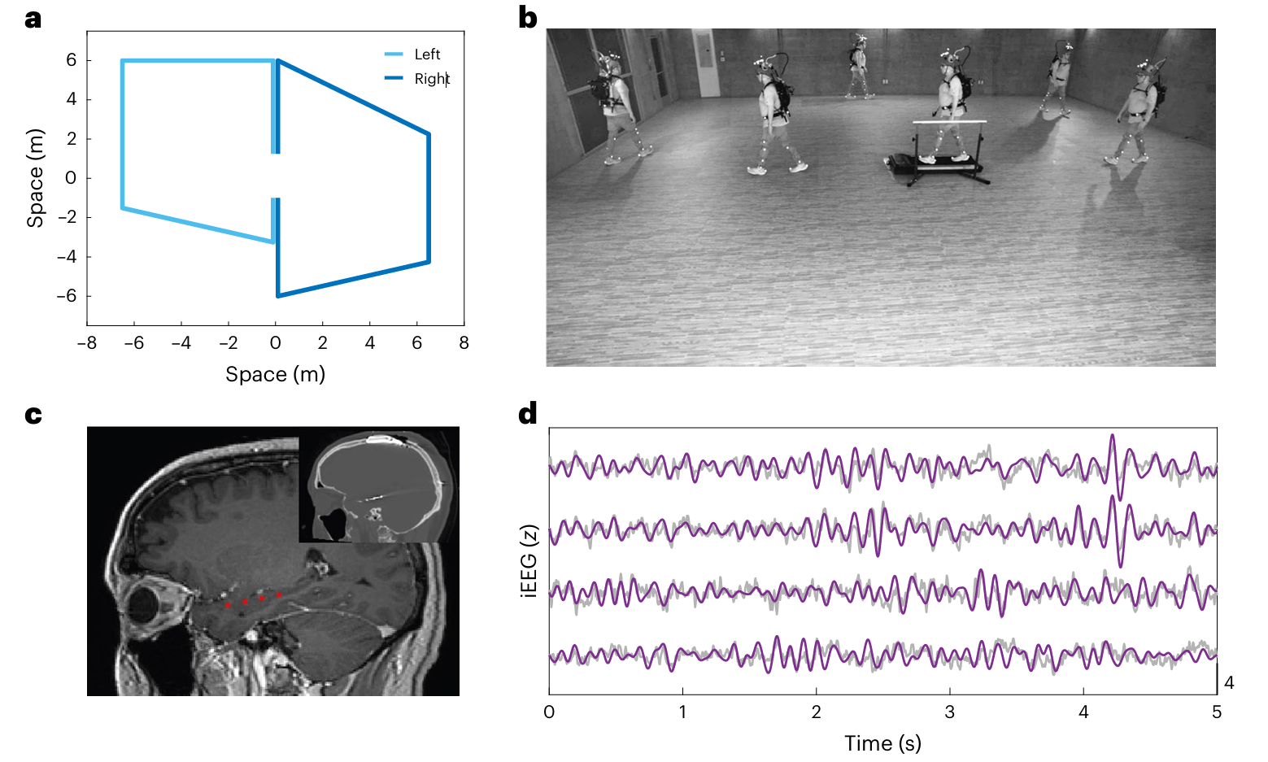
Experiment

Slide 7
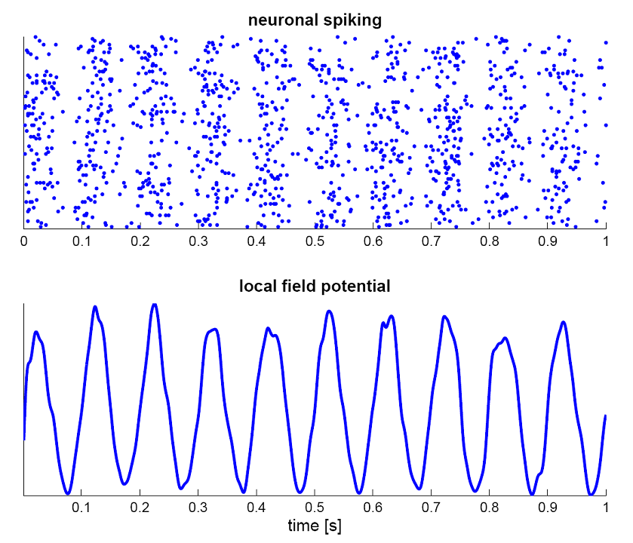
Neural Oscillations
Components of Local Field Potentials (LFP)
LFP represents bulk synaptic activity.
Frequency bands in LFP are associated with cognitive states and behavior.
Sleep, memory, locomotion, etc.
Frequency Band | Primary Association | Direction
Gamma (>30 Hz) | Sensory input, feedforward prediction errors | Bottom-up
Alpha/Beta (8-30 Hz) | Top-down predictions, cognitive control | Top-down
Theta (4-12 Hz) | Memory, spatial navigation, internal sequences | Internal/integrative

Slide 8
Neural Oscillations
Local Field Potentials (LFP)
LFP represents bulk synaptic activity
Frequency bands in LFP are associated with cognitive states and behavior
Sleep, focus, memory, etc.
Frequency Band | Primary Association | Direction
Gamma (>30 Hz) | Sensory input, feedforward prediction errors | Bottom-up
Alpha/Beta (8-30 Hz) | Top-down predictions, cognitive control | Top-down
Theta (4-12 Hz) | Memory, spatial navigation, internal sequences | Internal/integrative
Notes:
The point is that in this paper, we are not just looking at bulk population activity, but at temporally structured activity that is well-established in rodent navigation literature.
We get into the beta range during the bouts, fwiw

Slide 9
Navigation Tasks
Participants learn route
Motion tracking feedback after each training walk
Walking trials (36)
Treadmill + imagined walk (48)
Control treadmill (24)
Notes:
two distinct spatial trajectories, left and right turns
Since the angles and locations of turns on
these routes were not visible during real-world navigation, participants
had to learn and remember the walking patterns, with turns serving
as critical retrieval points.

Slide 10
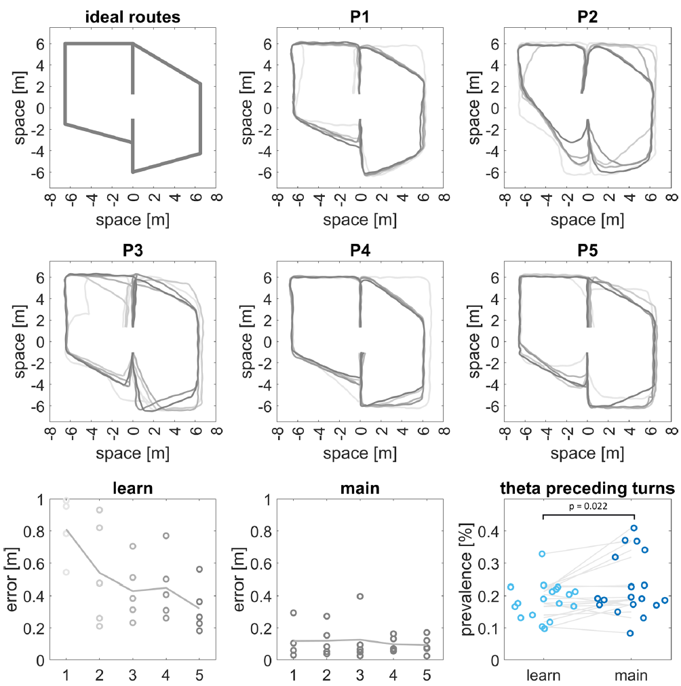
Learning

Slide 11
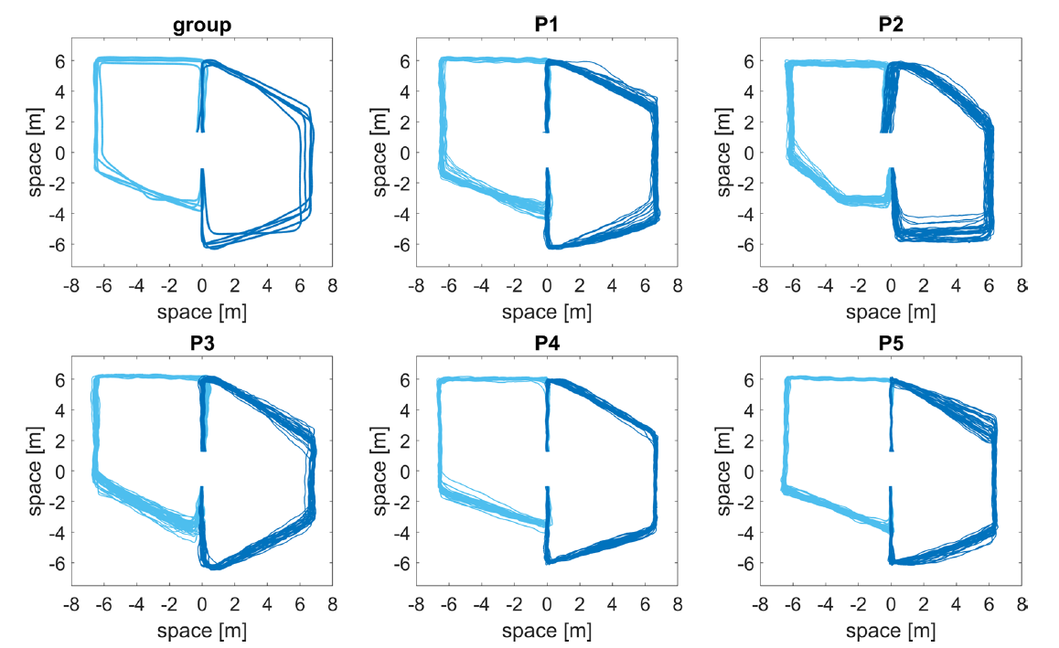
Walks
Notes:
Group lines illustrate the average walking routes of each individual participant
Subplots show 24 trials for each participant
P2 couldn’t learn the route as trained, so the researchers let them use their own route.

Slide 12
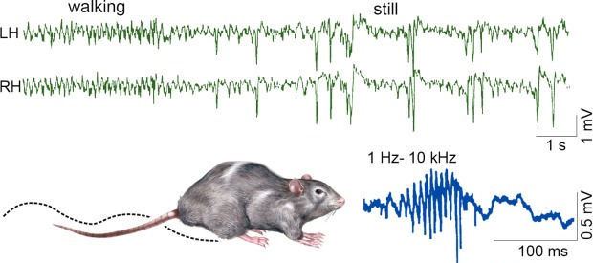
Theta In Rodents
Buzsáki et al. (1992)
Notes:
Behavior-dependence of hippocampal LFP activity. Top, LFP recorded from symmetric locations of the left (LH) and right (RH) dorsal CA1 str. radiatum during locomotion—immobility transition. Note regular theta waves during locomotion and large amplitude, bilaterally synchronous negative waves (sharp waves, SPW) during immobility. Below, SPWs recorded from str. radiatum (red) and ripple recorded from the CA1 pyramidal layer

Slide 13
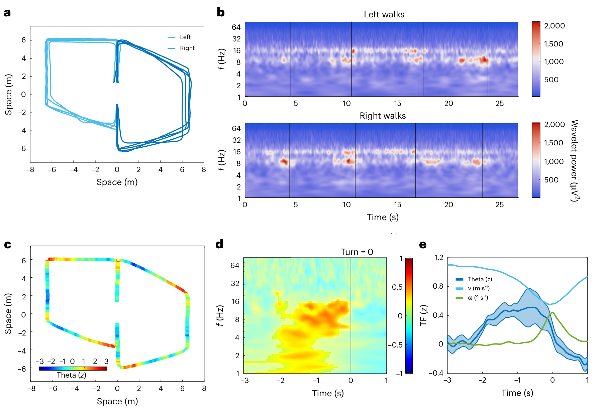
Theta Bouts Precede Turns
Notes:
b, Time–frequency plots of exemplary hippocampal activity averaged across trials reveal task related
and temporally organized theta oscillations during both left (top) and right walks (bottom).
c, Theta activity (z-scored) within the left anterior hippocampus
d,Average time–frequency (TF) activity aligned with all turns confirms the engagement and the temporal relationship of theta activity preceding turns (time = 0).
e, mean theta activity ― standard error juxtaposed with the speed and angular velocity of the hips, averaged across the group and aligned to turns
^theta power peaks *prior* to the initiation of the turn

Slide 14
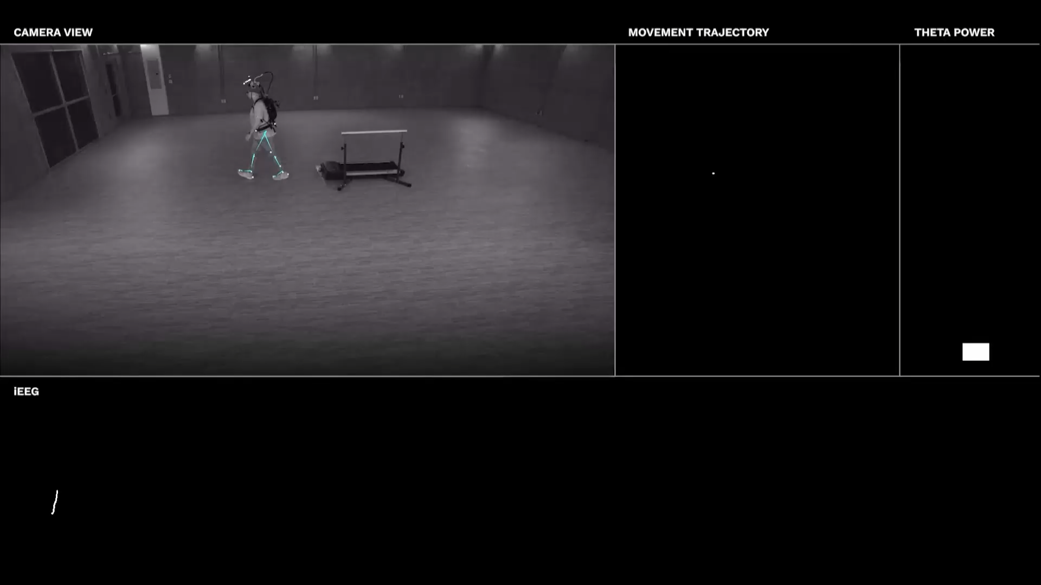
Notes:
After participants learned towalk the routes as instructed, the prevalence of theta bouts preceding turns was significantly higher than during the learning phase p=0.02
There was an attention check, in which participants reported their position relative to previously learned landmarks following an auditory cue.

Slide 15
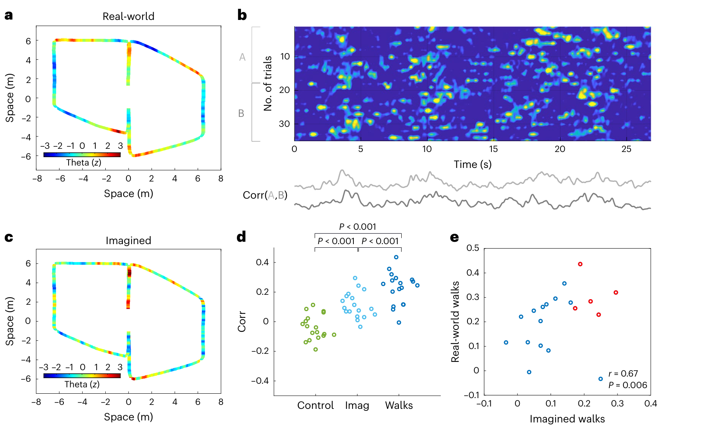
Real-World and Imagined Theta Activity is Correlated
Notes:
a, theta activity for real-world trials, averaged across the group and superimposed on the mean path of the group.
b, to assess temporal consistency, data were randomly shuffled and divided into two groups A and B, which we then correlated with each other.
Data in the example shows all the trials from one condition, on one electrode.
C, averaged theta activity from imagined trials superimposed on the group avg path.
D, temporal consistency values for each channel, each condition. Consistency is significantly higher for imagined than control (treadmill) trials. And higher for real-world than imagined.
E, electrodes with high temporal consistency for real trials also showed high temporal consistency for imagined trials. Red dots are anterior hc (advance slide)

Slide 16
Real-World and Imagined Theta Activity is Correlated
Anterior HC
Other
Notes:
The area/eectrode that best represented real world space also best represented imagined space
Each dot is an electrode
temporal consistency was spatially
correlated (two-sided linear mixed-effect model, β = 0.75, df of 16, 95% CI 0.25
to 1.24, P = 0.006) between real-world and imagined navigation. The electrodes
showing higher consistency in theta dynamics during real-world navigation
also demonstrated comparable consistency during imagined navigation,
suggesting the presence of analogous anatomical regions engaged in both types
of navigation.

Slide 17
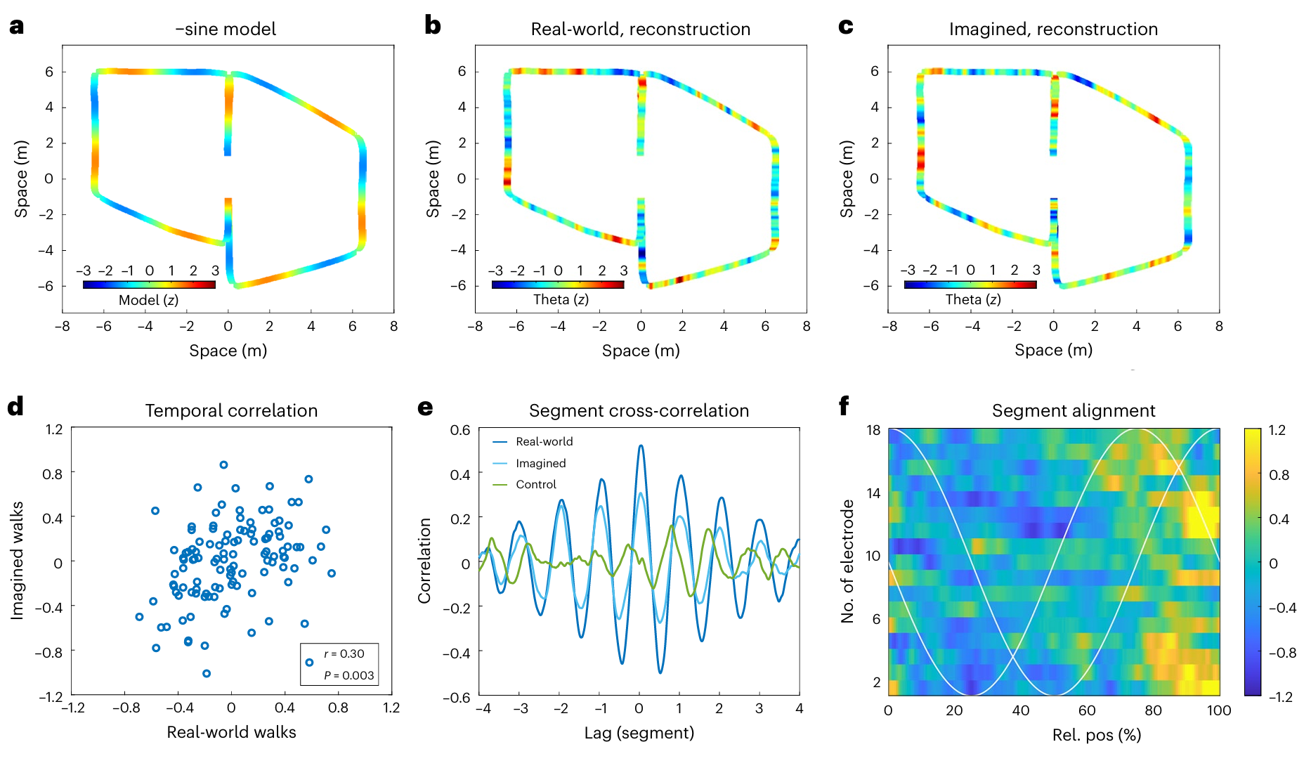
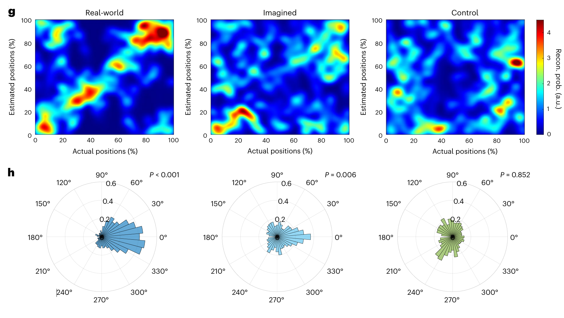
Relative Position Can Be Recovered From Neural Dynamics
Notes:
A, this is showing the –sine component that is to be predicted by neural data. This is showing the actual position, each segment is a 360deg cycle.
B, after training on neural data, this is a prediction of the relative position in the cycle for real-world neural data
C, the model, trained on real world data, is then used to predict time-warped segments for the images segments. We still see good results.
Control trials are chopped up into The same procedures for position estimation and time alignment were applied to the sole treadmill walking data, serving as control analyses

Slide 18
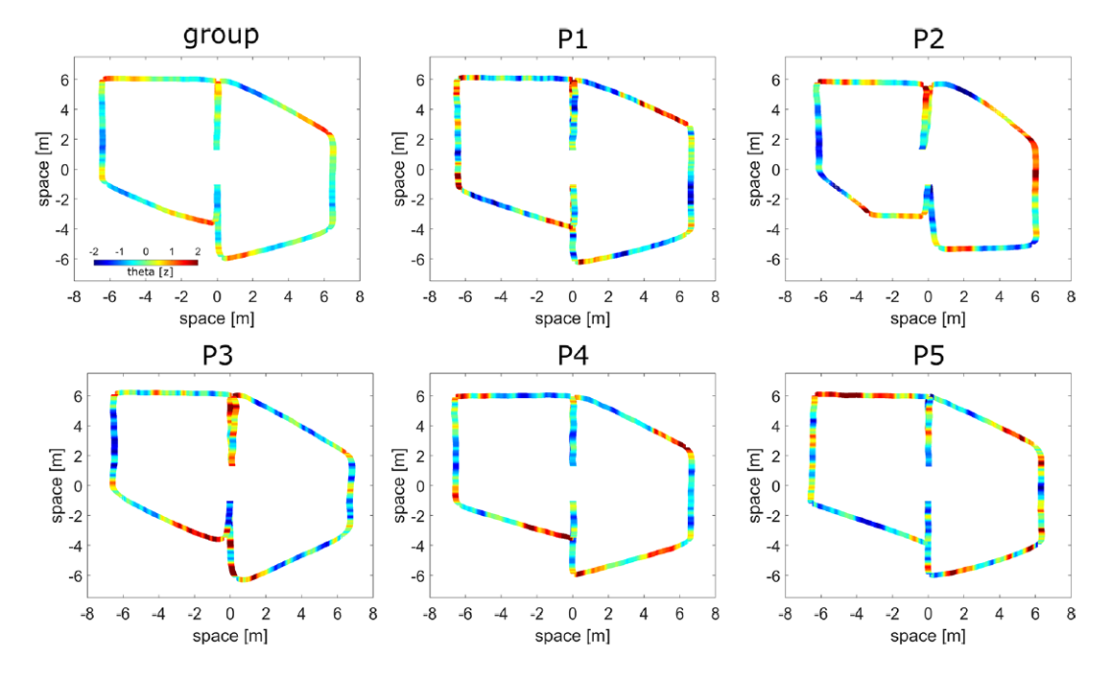
Supplementary Figures
Notes:
Recording sites were not the same across all participants
P2 couldn’t learn the route as trained, so the researchers let them use their own route. We still see a theta bump at the extra turn they took on the ‘right’ route.

Slide 19
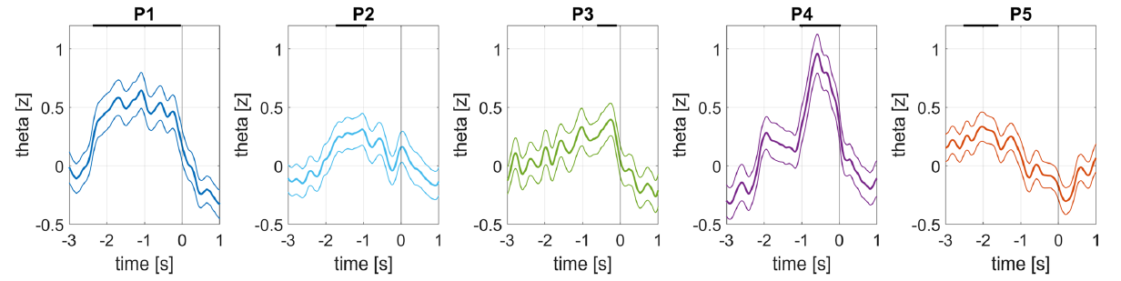
Supplementary Figures
Notes:
Recording sites were not the same across all participants, but it’s interesting that p4 had a pronounced and acute bout and performance was also excellent

Slide 20
Findings
“Our findings highlight the role of transient theta oscillations in partitioning complex navigational routes and episodes into discrete segments, showing a striking similarity in real-world and imagined navigation.”
Notes:
Zheng, J. et al. Theta phase precession supports memory
formation and retrieval of naturalistic experience in humans.
Nat. Hum. Behav

Slide 21
Findings
“These findings resonate with studies on event boundaries delineating ongoing experiences.”
Notes:
Zheng, J. et al. Theta phase precession supports memory
formation and retrieval of naturalistic experience in humans.
Nat. Hum. Behav

Slide 22
Findings
“Theta bouts preceding turns also complement prior findings of theta bouts occurring after cognitive boundaries during movie watching.¹”
1. Zheng et al. (2024)
Notes:
Zheng, J. et al. Theta phase precession supports memory
formation and retrieval of naturalistic experience in humans.
Nat. Hum. Behav

Slide 23
Discussion
Do you guys care about oscillatory dynamics?
How much of an obstacle is low temporal resolution?
Thoughts on the article?

Slide 24
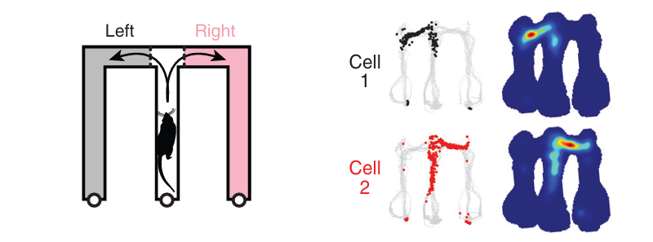
Possible Futures
Kay et al. (2020)
Notes:
temporal consistency was spatially
correlated (two-sided linear mixed-effect model, β = 0.75, df of 16, 95% CI 0.25
to 1.24, P = 0.006) between real-world and imagined navigation. The electrodes
showing higher consistency in theta dynamics during real-world navigation
also demonstrated comparable consistency during imagined navigation,
suggesting the presence of analogous anatomical regions engaged in both types
of navigation.

Slide 25
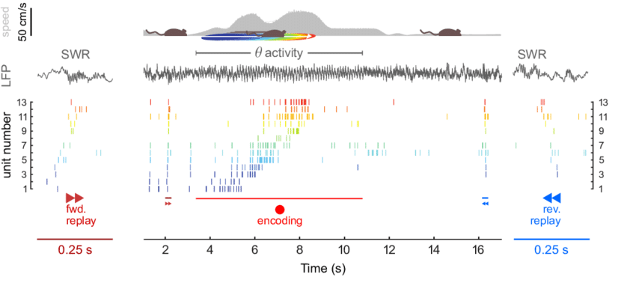
Sharp Wave Ripples
Diba & Buzsáki (2007)
Notes:
temporal consistency was spatially
correlated (two-sided linear mixed-effect model, β = 0.75, df of 16, 95% CI 0.25
to 1.24, P = 0.006) between real-world and imagined navigation. The electrodes
showing higher consistency in theta dynamics during real-world navigation
also demonstrated comparable consistency during imagined navigation,
suggesting the presence of analogous anatomical regions engaged in both types
of navigation.

Slide 26
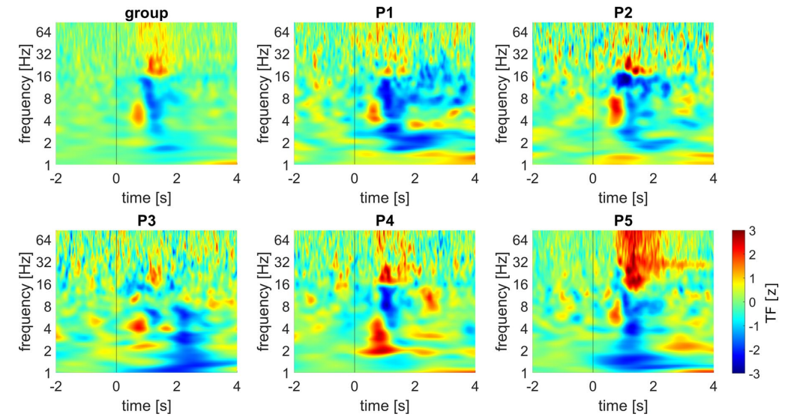
Beta & Self-Report
Notes:
temporal consistency was spatially
correlated (two-sided linear mixed-effect model, β = 0.75, df of 16, 95% CI 0.25
to 1.24, P = 0.006) between real-world and imagined navigation. The electrodes
showing higher consistency in theta dynamics during real-world navigation
also demonstrated comparable consistency during imagined navigation,
suggesting the presence of analogous anatomical regions engaged in both types
of navigation.

